Slide 2
Gathering for Mission Paul Booth: Director of Mission

Slide 3
Outcomes: 1. Reflect on our cultural context(s) 2.Re-evaluate our mission 3.Identify opportunities

Slide 4
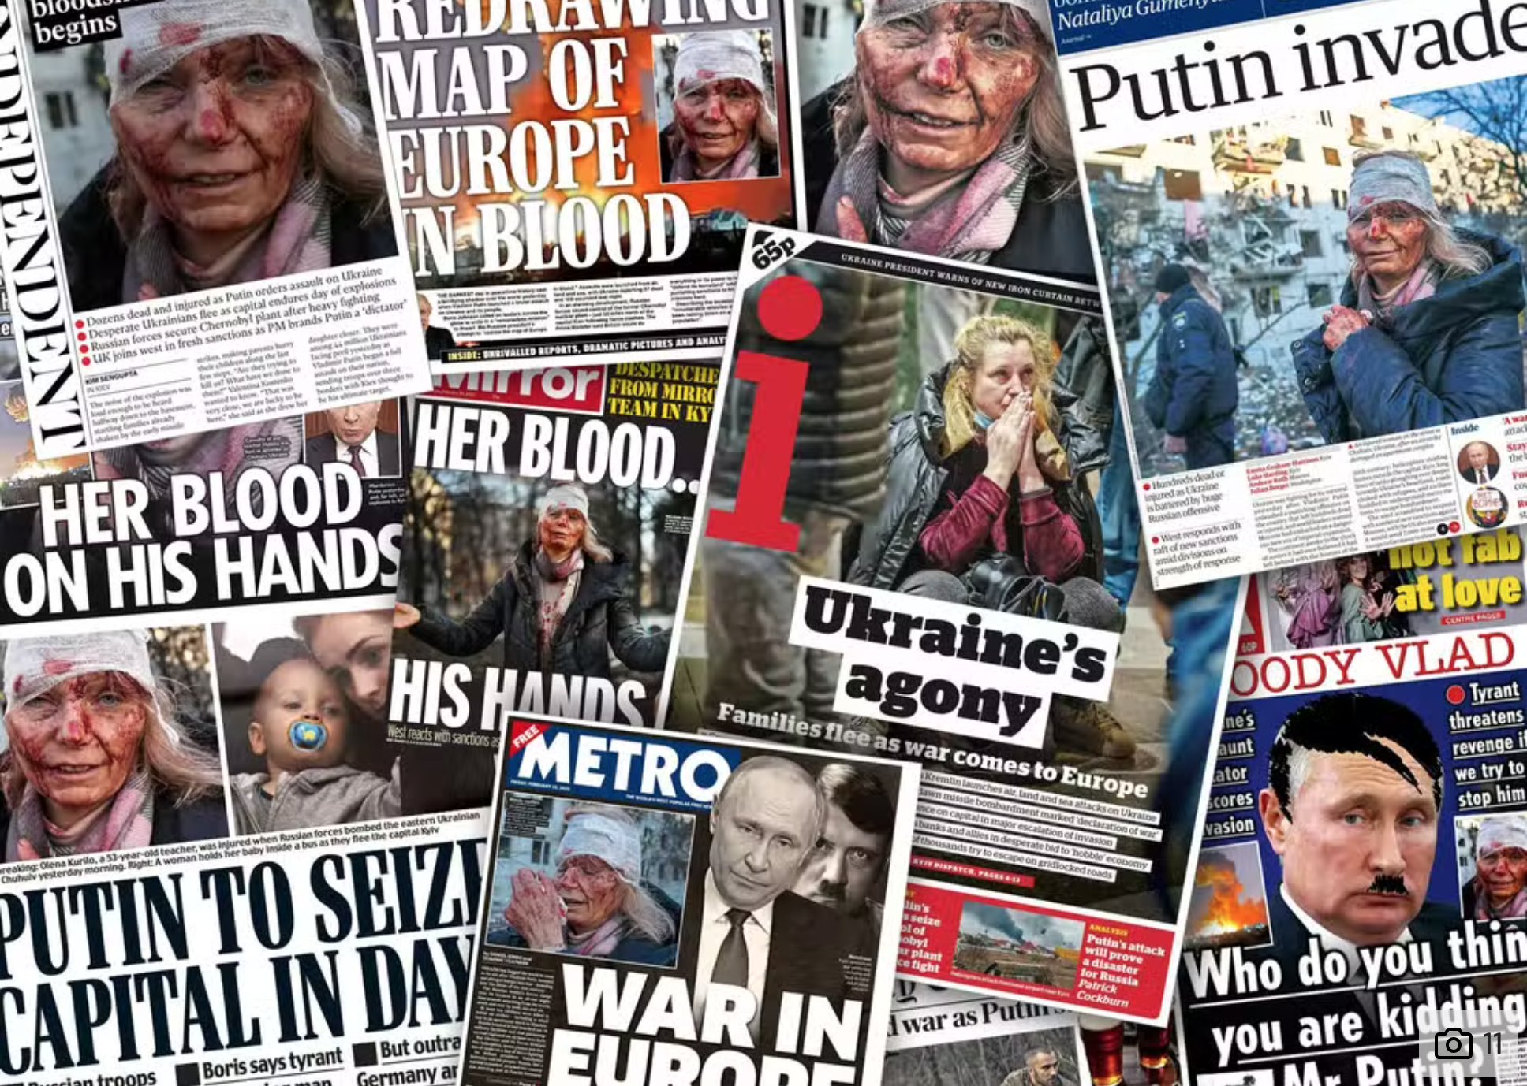
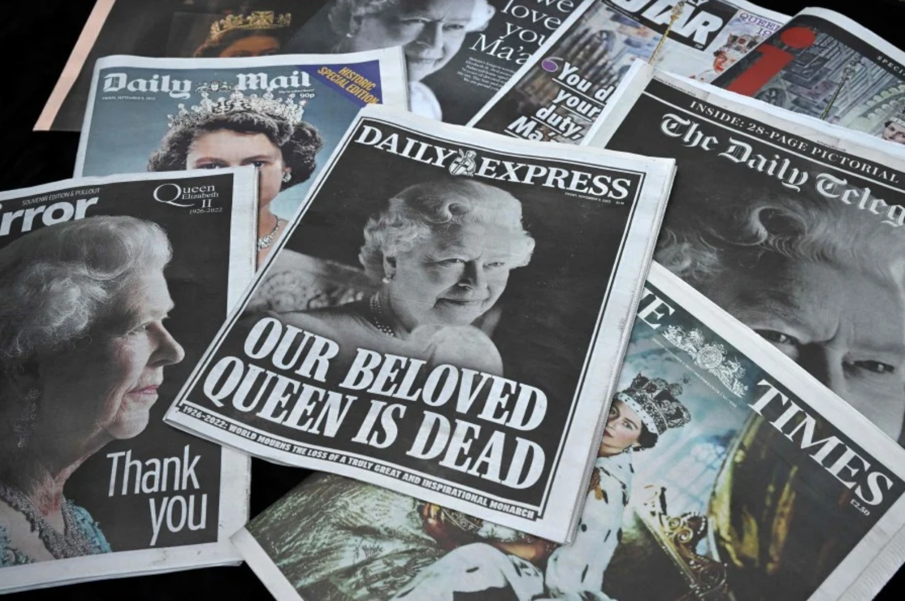
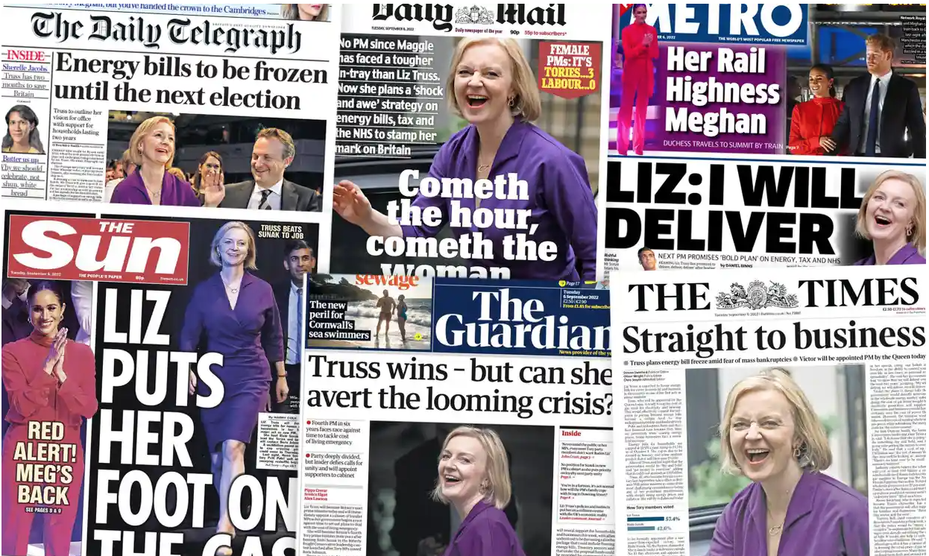
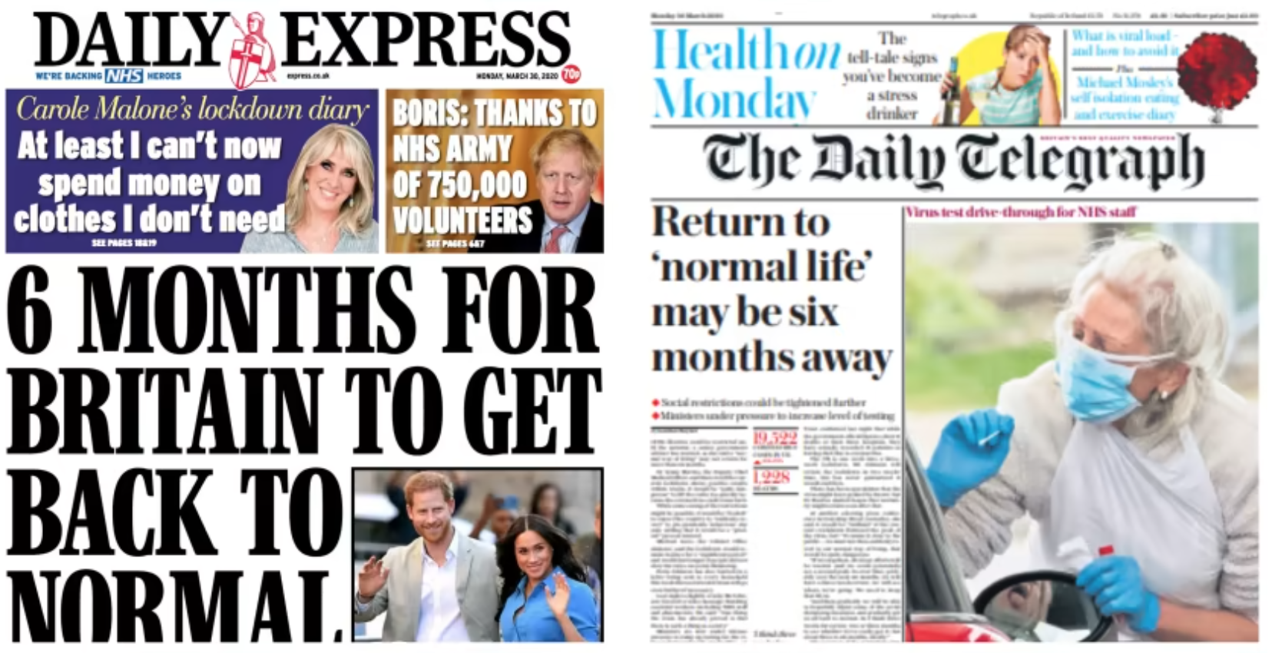
Notes:
Context in which we live: Headlines from the last 8 months
War in Europe
Pandemic
Energy crisis
Climate change crisis
Political crisis

Slide 5
Notes:
(Never Give In, The Extraordinary Character of Winston Churchill, Page 190)

Slide 7
Notes:
Might it be that the Queen in her death is somehow “wooing an errant generation back to the faith of their fathers”?
Maybe you are not into the Monarchy. Globally significant event. 50% of world watched a Christian ceremony where the Gospel was preached. Biggest gathering of world leaders in a generation
Was a moment of history.
Biblically there is something about the death of a monarch that seem significant spiritually. Uzziah died and see Isiah seeing the King of Kings
Cultural chaos in the world as we have seen through our headlines or see as Isaiah it was a moment of clarity and epiphany..
A moment of sending out. More positive commentary on Christian faith than we have had in a long time. Confident that we can share our faith at this time. Surely our individual prayers should be that we encounter Jesus Christ afresh in our own lives and allow him by His Holy Spirit to fan into flame the embers. Harvest fields are ripe and we want to pray that he would send workers. Not just clergy but ALL of us.

Slide 8
The mission of the Church is the mission of Christ
To proclaim the Good News of the Kingdom
To teach, baptise and nurture new believers
To respond to human need by loving service
To transform unjust structures of society, to challenge violence of every kind and pursue peace and reconciliation
To strive to safeguard the integrity of creation, and sustain and renew the life of the earth
Notes:
The Western Church has focused to some extent on 3 4 and 5.

Slide 9
TELL
GROW
BUILD
Transformed lives:
Notes:
We want people to encounter and know the love of God
Outcome: Transformed lives through living and bearing witness to Jesus Christ
This is achieved by:
Telling a joyful story
Growing the Kingdom of God
Building our capacity for good

Slide 10
At which point in the cycle is your MA currently engaging?
What will be your next steps?

Slide 11
Joyful stories

Slide 14
FAMILY
CELEBRATION
MEDIA
EDUCATION
RELIGION
ECONOMICS
GOVERNMENT
7
spheres
of
society
Notes:
We are not speaking into a void. Helpful to think about the context of society that we seek to reach OUR MISSION FIELD. This should can act as a framework of reference.
Sphere of society: (influence)
Ever more widely used phrase (spheres of influence) are the various dimensions of life that come together to make up society as we know it.
Terminology originated within the church became more widely used as organisations in the non-religious sphere (particularly the economic) sought new terminologies outside of their own to help frame discussion about social impact and issues.
The general concept is gaining traction as the conversation around reforming society seeks a simple way to look at the complexity of social issues.
No-one sits in a single sphere. Everyone is a mix.
Government
Economics (Science, Technology and Business)
Faith, Spirituality and belief
Education
Family
Media
Celebration (Arts, Entertainment and Sports)

