Slide 1
Resourcing for Mission
James Laing
Diocesan Secretary

Slide 2
We love because He first loved us
1 John 4:19
Why should I give?
How much should I give?
How can I give?

Slide 3
Why Should I Give?
Mark Brampton

Slide 4
How Much Should I Give?
James Laing

Slide 5
Demystifying Financial Flows
All MAs contribute to Fairer Share which reflects the shared Mission of our Diocese.
This enables us :
To pay for the work of our own ministry in the Ministry Area
To train clergy
To support ministry and mission throughout Llandaff; in MAs less able to sustain their ministry and with young people in schools
To support ministry, outreach and mission in the wider world
With your generosity and through the grace of God we can continue this work and grasp new opportunities which arise.
Notes:
Thank you Mark for those thoughts. I am now going to take a little time to think through what happens to the money we give.

Slide 6
Doing a new thing
Changing, challenging, uncomfortable …
… but together:
We are Church
We are giving
We are growing
Growth comes with clerics. How much do you think a cleric costs? How much do we need to sustain, or grow, ministry?
Notes:
We have heard today, from Bishop June and Mark and in other conversations, inspiring, yet challenging messages. Particularly at a time when all of our bills are rising, interest rates have just increased again – BofE to base rate to the highest rate since 2008, inflation breaking similar records.
But we cannot just cut our cloth. An organization that is not growing is dying, like a living being. Sermon last weekend about our wonderful creator God and His creation, with human beings created in his likeness. Every second 1 million cells die in the human body – and another million are made. We are growing, creating beings – and so is our church. If we cut off the clerics, who inspire us, lead us, and keep us connected to God and growing in his likeness – if they decrease, it is likely that membership will decrease. Salami-slicing which leads to a vicious cycle of decline. If however we invest in our clergy, it is more likely that we can grow the kingdom.

Slide 7
Stepping out in faith
Our clergy numbers are growing:
Experiment with different models
Support foodbanks, hostels, Alpha, refugees
Diocese | 2012 | 2022
St Asaph | 89 | 76
Bangor | 44 | 34.5
St Davids | 102 | 77
Llandaff | 102 | 116
Monmouth | 69 | 49
Swansea & Brecon | 73 | 41.5
Notes:
We have kept our promise not to decrease clerics with the establishment of Ministry Areas, but to increase them: we have stepped out in faith
Similarly, we are asking them to step out, and asking you all to act in faith, experiment with different models, retreat to advance, re-engage with ancient ideas like the Minster model, plant new churches, grow network churches
Our giving also supports service to the community – foodbanks supplied, children educated in church schools, lives changed through Alpha, Kindness shown to those living in Salvation Army hostels, refugees upskilled, Senghenydd reopened etc

Slide 8
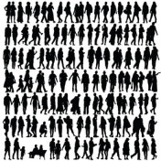
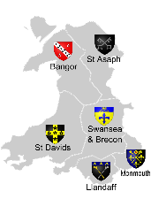
Operational Budget 2022
Income
Expenditure
Support for
parishes
£0.6m
Ministry
£5m
Fairer Share
£4.3m
Representative Body grant
£0.5
Property
£1m
Grants
£0.2m
Investment
income
£0.1m
Evangelism Grant
£0.6m
Other
income
£0.4m
Governance & Communication
£0.2m
Income Total - £5.9m
Expenditure Total - £7m
But in 7 years we will run out of reserves, UNLESS …
Notes:
What about those costs and plans? You may recognize this slide from Mike Lawley’s presentation on Thursday, of the DBF budget. Let’s pull back and look at a longer timescale.

Slide 9
Ministry or Mission?
Notes:
You won’t be able to read all this, but take my word for it that it shows trends from 2013 to 2023: our total diocesan income in each left hand column, and total expenditure in each right hand column. What I want you to look at is the largest block at the bottom of each column. The orange block of income is Fairer Share, and the dark grey block of spend covers ministry and parsonages – ie the cost of clerics. The rest of the income is grants, mostly from the RB; and the rest of the costs are support for parishes, grants, communications and governance, and latterly the diocesan vision. We would love for the living church to pay for front line ministry – ie that fairer share covers the costs of clergy, so that other grants and other income can be focused on the vision and growth, as well as funding the back office machinery to make sure the diocese runs smoothly. However up to now, fairer share has not covered the costs of ministry.

Slide 10
Over to you!
Breakdown of costs
Per MA
Clergy Stipendiary & on-costs
£121,911
£32,645 per cleric
Clergy Housing
£40,661
£10,088 per cleric
Training and Support
£33,148
Growth
?
Fairer Share
£155,732
£600 pppa
Or £11.55 pw
Notes:
Now we will do a hypothetical exercise, some fun to try our brains to apply the ideas Mark was talking about moving away from a culture of taxation and obligation, of how little I can get away with, and towards generosity and joy, gratefulness and how much can we invest together. The DBF will also pledge, to revise Fairer Share for 2024, so that it really is fairer and supports our joint efforts striving for growth together.
This is what it costs to sustain ministry in each MA: 3.7 clerics, including housing and on-costs (each cleric costs £33k + housing £11k on average), and some support to the running of the diocese and wider church (DAC, Stewardship adviser, rebates FS, safeguarding, lay training). But our budget includes additional grants and people to support mission, evangelism and growth – currently the DBF is putting £50,145 per MA into investing for growth in 2023 budget. How much can you, in your Ministry Area, give to support the growth of the Kingdom? Now I am going to ask you what you think your MA could contribute, to cover the costs of ministry and to go for growth? Perhaps think about what it means per person per week: £11.55 is less than three cups of coffee, less than a train fare from Cardiff to Port Talbot. Think about it, discuss it on your tables for 10 minutes or so, and then we will turn back to plenary and see if anyone is brave enough to share their figures!

Slide 11
How Can I Give?
Mair Henry
Director of Finance, HR & Administration

Slide 12
YOU CAN’T HELP BUT GIVE GENEROUSLY, WHEN YOU HAVE ENCOUNTERED THE GENEROUS GOD.
Jesus! He became poor that we might become rich. God is generous towards us. We ought to be generous in return.
We give to our Church, because we cannot afford not to. If we give with a generous heart, all our needs are met.
Notes:
How great to see those pledges, even if they are hypothetical! Our motivation is to give in response to the generosity of God.
And the Diocesan team is ready to support you in all this, with tools and communications to talk about giving and to make it easier.

Slide 13
Notes:
On the Diocesan Website, look under the Ministry Support tab, and click on “Finance”. The top item is “Generosity Matters” with links to Giving for Life, Online Generosity and other resources.

Slide 14
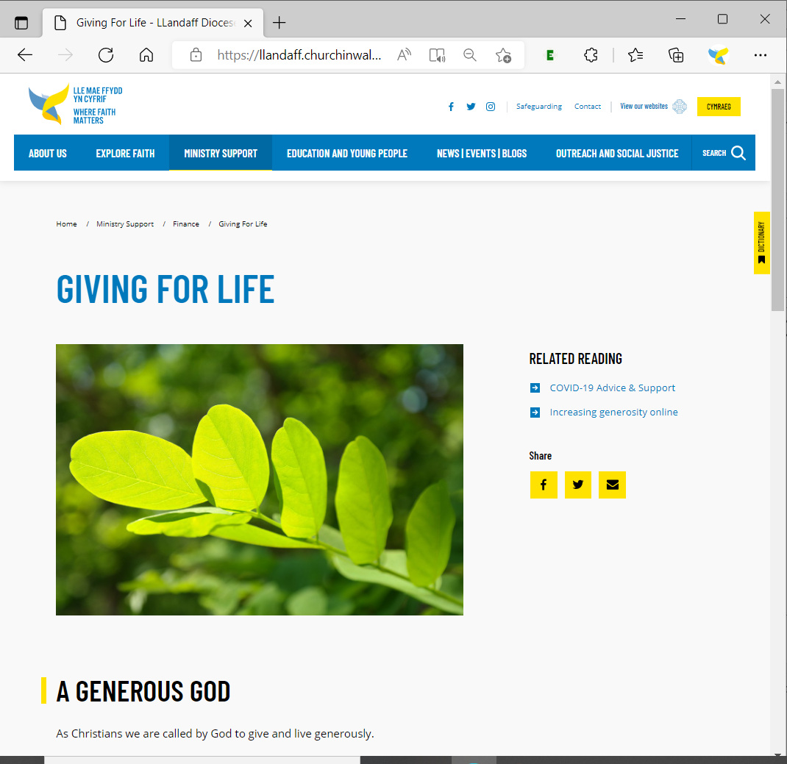
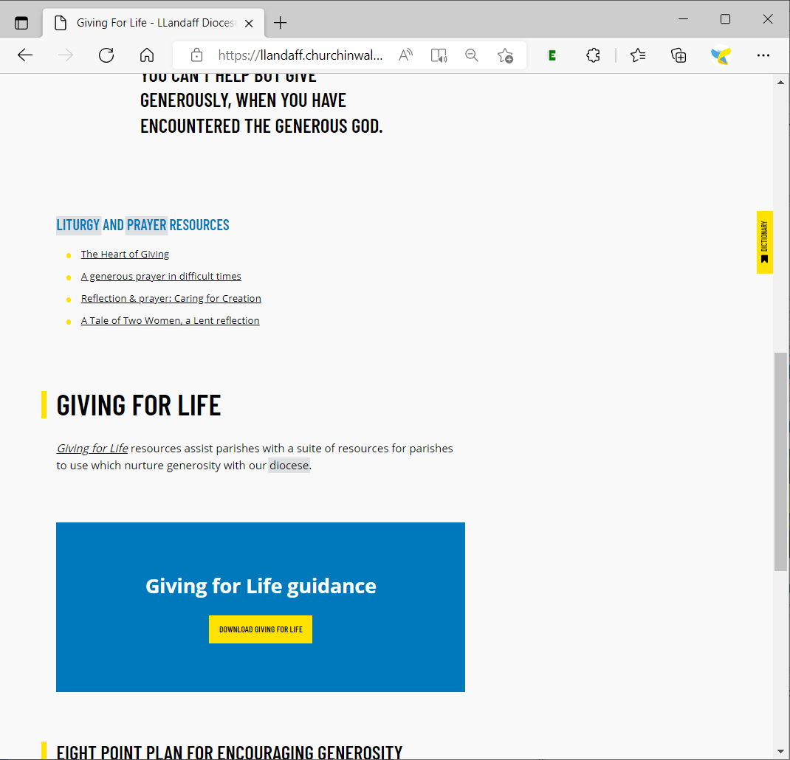
Giving For Life
Notes:
Some of you may be familiar with Giving for Life. It helps parishes review their approach to issues of stewardship and generosity, within a context of discipleship. There is a link from our website to a wealth of online resources, including a Leader’s Guide, information sheets and videos for MAC members, an Assessment and action plan templates as well as communications advice and resources. It has been enthusiastically commended by church leadership and taken up by many parishes:
It sets giving within the context of discipleship and mission
It encourages church members to set targets of giving to help build God’s kingdom, like the exercise we have just done
It is commended for prayerful discussion and action.

Slide 15
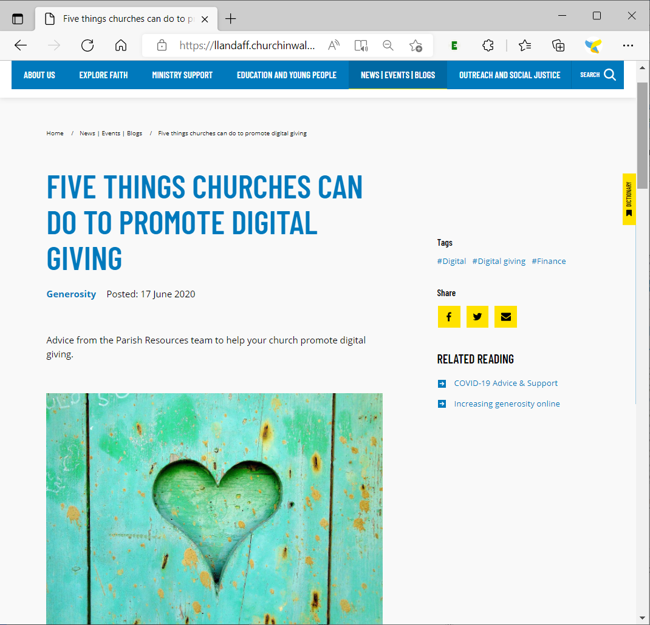
Regular Giving in the 21st Century
Notes:
The diocesan website provides a framework of an 8-point plan to engage in generosity and giving as discipleship. There are particular ways to enable some of this using online resources, which some of our MAs have done brilliantly, and we can all continue to improve. Our website includes tips and links to help with text to give, tap to give (or contactless giving devices – which the DBF will help pay for – and one of our churches found that the contactless giving device paid for itself within 2 days), and direct regular giving – not forgetting GiftAid and tax reclaims: it is important to claim the money that we are eligible for! Following our push and publicity during lockdown into regular giving and Gift Direct, Llandaff saw the biggest shift to Gift Direct and an increase of £???. One of our parishes did a snapshot survey recently which showed that while attendance had declined up to 30% during covid, giving shifted from the plate to regular/Gift Direct so total giving remained high and income fairly constant.

Slide 16
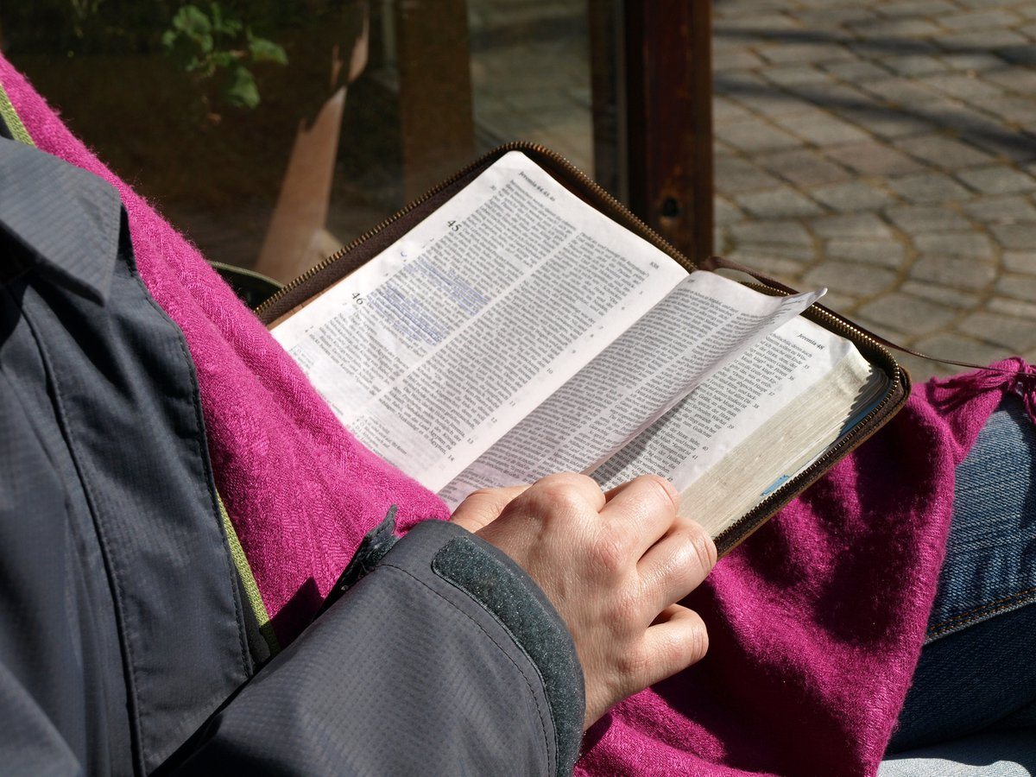
Engage with Scripture
Respond to God’s generosity, and to the Bible
The widow gave all she had which meant trusting in God's provision
REMEMBER THIS: WHOEVER SOWS SPARINGLY WILL ALSO REAP SPARINGLY, AND WHOEVER SOWS GENEROUSLY WILL ALSO REAP GENEROUSLY. EACH OF YOU SHOULD GIVE WHAT YOU HAVE DECIDED IN YOUR HEART TO GIVE, NOT RELUCTANTLY OR UNDER COMPULSION, FOR GOD LOVES A CHEERFUL GIVER.
Notes:
Engage in Scripture – Jesus spoke more about money than any single other subject. These are quotes and stories that will be familiar. There are plenty more. Preach and teach about it. Mention it in newsletters and social media. Let’s not be so British and restrained, but make it a normal part of our faith and our life.

Slide 17
Share the Vision
People's lives been changed through Alpha, Salvation Army hostels, refugees upskilled, Senghenydd reopened etc. I'm happy to give into a vision.
– and the impact!
Giving to the church knowing the positive impact it has on supporting families is a key factor for me
Say Thank You!
Notes:
Behind, supporting and surrounding these tips and techniques, are some fundamental principles and behaviours. We have discussed how we are church, we are in this together; how together we respond in generosity to the spirit of a generous God. People give towards a shared vision.
Feed back, tell people what is being done, share joyful stories in church services, at the start of prayer meetings, on social media posts, in newsletters, in Llandaff Matters – and the communications team will be there to help.
Thank people for their donations: a simple thank you letter went from the Bishop last year to people who continued to give faithfully through Covid, without any request for more giving – and several people mentioned how valued they felt, and raised their giving levels spontaneously.

Slide 18
Enabling Ministry
Archdeacons Visitations will help you dream and plan
Diocesan Communications Team will help with leaflets and digital communications
New Stewardship advisor
Notes:
Our team can help you with communications approaches, language and materials.
And next week we will start recruiting a new, dedicated member of staff to help with all things to do with giving and MA finances.

Slide 19
What more is needed?
Notes:
You have heard from me about what has already been done and planned. We are Church acting together, so we want to make sure that in the MAs you have the resources and support you need. What else can we do? Have a buzz on your tables, and write some suggestions for us. [If time, then we will come back in plenary to hear your suggestions before the coffee break.]

