Slide 1
Highlights 2019 - 2020
Matthew Batten
Director of Communication and Outreach

Slide 2
Year of Pilgrimage

Slide 4
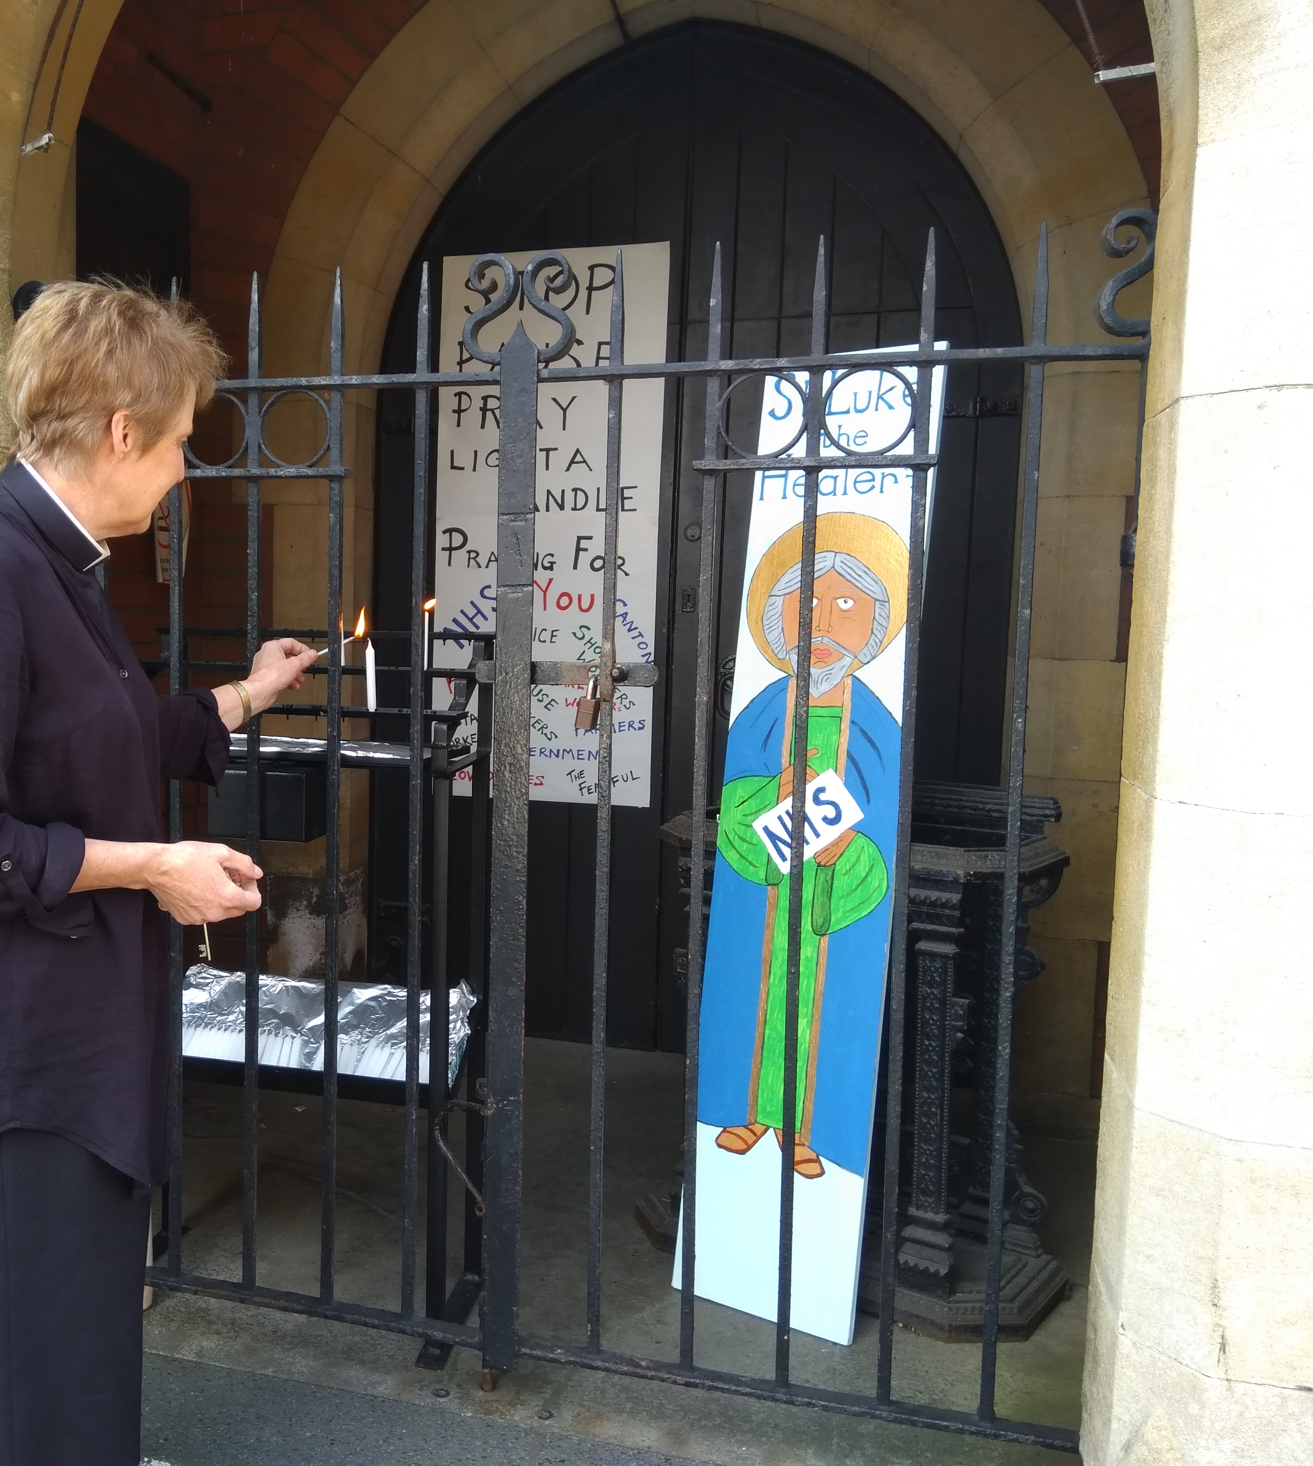
Outreach

Slide 5
Online ministry

Slide 6
Generosity Matters
861 Gift Directs across CinW.
230 from Llandaff
£8,165 extra every month for parishes.
£120,284 extra per year (with tax).

Slide 7
Eco Diocese
25 Churches are registered and working towards an award.
9 have achieved the bronze award.
5 have achieved the silver award.

