Slide 1
: A story from a Mission Area In the Diocese of St Asaph
A Mission Area Warden’s Story
John Gambles

Slide 2
Our Diocese
More than 7,000 people from across north east and mid Wales regularly participate in services, events and activities in the 216 churches
Covers the counties of Denbighshire, Flintshire, Wrexham, half of Conwy and part of Gwynedd and Powys.

Slide 3
Prayerful aspirations
Between 2013 and 2017 the Diocese of St Asaph set out its prayerful aspirations in this way:
Deepening our Discipleship
Increasing Participation
• Identifying and developing our future leadership
• Extending God’s Welcome
Establishing Mission Areas was seen as key to realising these

Slide 4
Moving to Mission Areas
All churches involved in facilitated consultations
Emerging Mission Areas formed of groups of churches
Some movement of churches between MAs in this process
Currently 20 Mission Areas group together over 200 churches

Slide 5
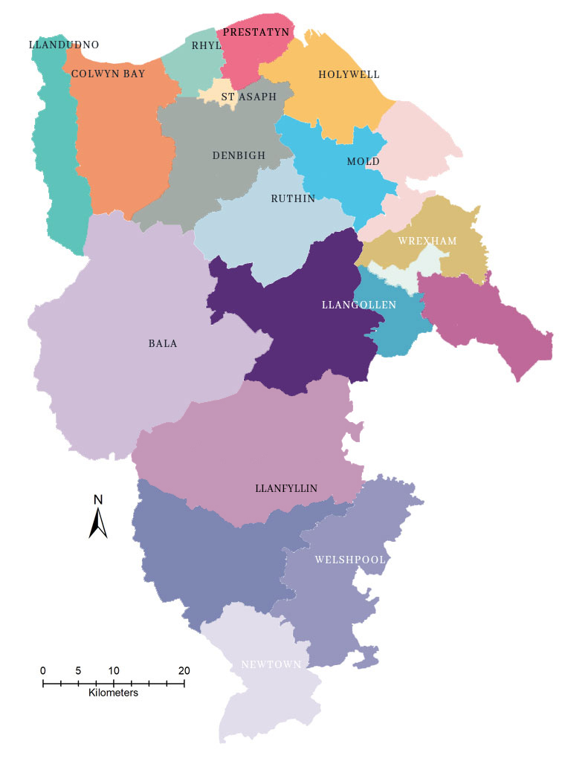

Slide 6
What is a Mission Area?
A gathering of people of faith, working together to preach the gospel and serve their communities.
The Constitution of the Church in Wales defines the role of the Mission Area as: “The promotion of the whole mission of the Church, pastoral, evangelistic, social and ecumenical”
Pastoral – looking after people
Evangelistic – telling people about Jesus and God
Social – inviting people to be part of the church family, and serving the communities forming the Mission Area
Ecumenical – working with other faith organisations in serving our communities

Slide 7
Structural Organisation
The Mission Area is the Charity run by the Mission Area Conference (MAC) of Trustees
Individual churches no longer have separate charitable status
One Trustee from each church together with clergy and 2 elected Wardens comprise the MAC

Slide 8
What does the MAC do?
Responsible for all church buildings in the MA
Responsible for Finance
agreeing and collecting the share from each church and paying the share to the Diocese
Claiming Gift Aid for churches
Producing consolidated inspected annual accounts
Responsible for strategic planning for worship and pastoral care in the MA

Slide 9
What lessons have we learned?
Change of this order takes time
churches and individuals can feel threatened by the loss of autonomy
Communicating the message that the MA is not a barrier but is there to support is key
The early adoption of a shared mission or covenant is vital
The MAC needs to be strategic and willing to delegate to sub groups including the church committees (ex PCC) to work towards the shared mission
Delegated powers need to be clear to all

Slide 10
What have we achieved?
Agreed a Covenant, a shared vision, and priorities for action
Developed a much fairer allocation of the share between our 11 churches
Provided financial help for those few churches that have really struggled to pay over the last 3 years
Provided mutual support and advice and some central services (Sunday Readings Sheets, Gift Aid, Clergy Expenses, Water Rates, Copyright Licensing, and, of late, weekly resources for Worship during closure

Slide 11
Mission Area Review
All our MA are currently being reviewed by the Bishop and his staff
We are supplementing this by conducting our own self evaluation

Slide 12
MAC Self Evaluation
Exploring at how we can better support our churches to achieve mission and growth
Set up strategic review groups for
Ministry
Property
Finance
Governance and Administration
Communication

Slide 13
Individual Church Self Evaluation
Exploring how we can achieve mission and growth
what are we good at?
what can we do better?
how well do we welcome in?
how can we be more welcoming?
how well do we reach out?
how can we reach out better?
what resources do we need to help us achieve this?

Slide 14
Next Steps
Bring the Bishop’s Review and the MAC and Church Self Evaluations together to identify key priorities
Develop a three year action plan to ‘unlock our potential’

